Slide 1
Advanced/Chemical Recycling: Comparing Approaches in the U.S. and EU September 2023
Prepared for Transport Energy Outlook Members

Slide 2
Presentation Overview
Background: Drivers for Advanced Recycling
U.S. Approach: Big Controversy
EU Approach: Big Waste Problems
Conclusions
What is Advanced or Chemical Recycling?

Slide 3
Background

Slide 4
The Problem: Plastics Production Continues to Increase

Slide 5
Waste Is Growing and Is Not Well Managed Plastics responsible for 3.4% Global GHG Emissions
Source: OECD, 2022

Slide 6
What Is Advanced or Chemical Recycling?

Slide 7
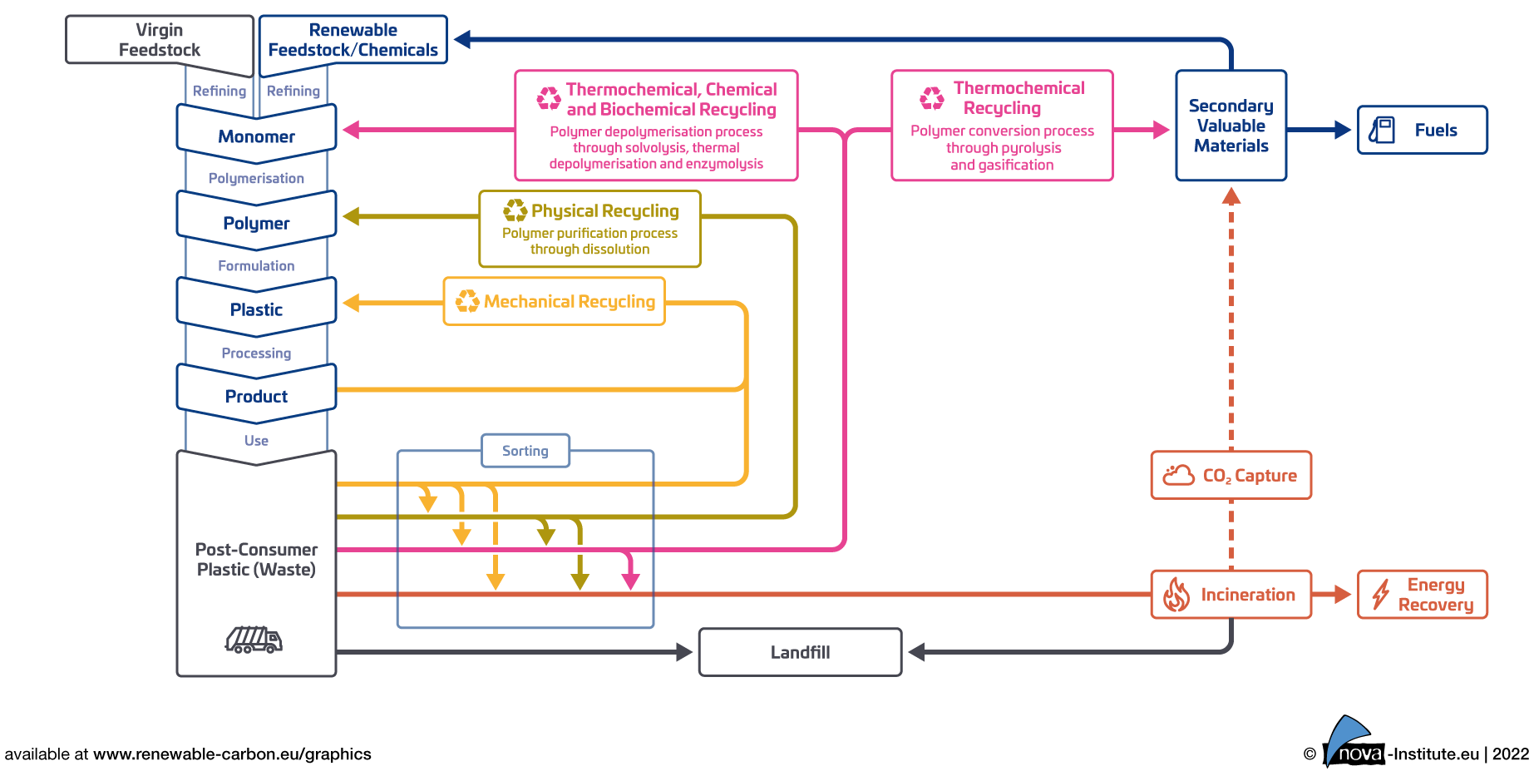
What Is Advanced/Chemical Recycling?
Plastic Recycling and Recovery Routes
Advanced recycling, also commonly referred to as molecular recycling and/or chemical recycling, is a diverse sector that addresses plastic waste and encompasses dozens of technologies that use solvents, heat, enzymes, and even sound waves to purify or break down plastic waste to create polymers, monomers, oligomers and/or hydrocarbon products

Slide 8
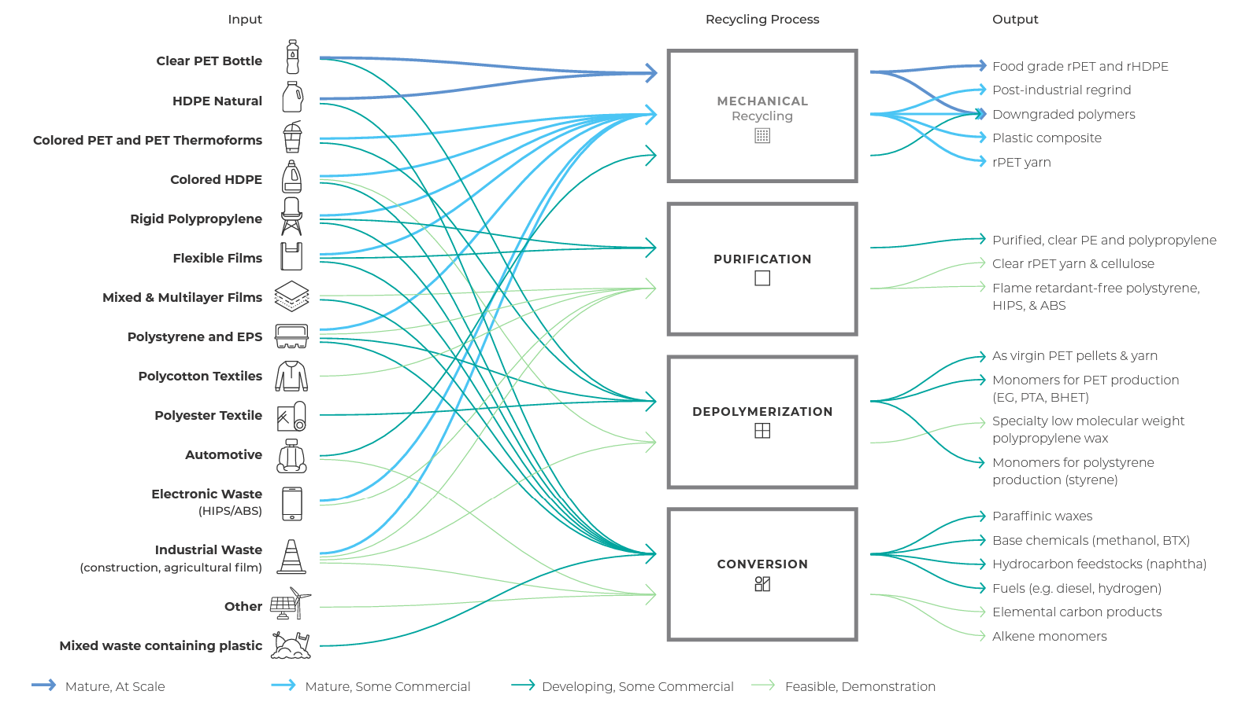
Recycling Processes, Outputs & Their Technological Maturity Level
Recycling Inputs and Outputs: Early and Developing Material Flows by Technology Category
Source: Closed Loop Partners, September 2022

Slide 9
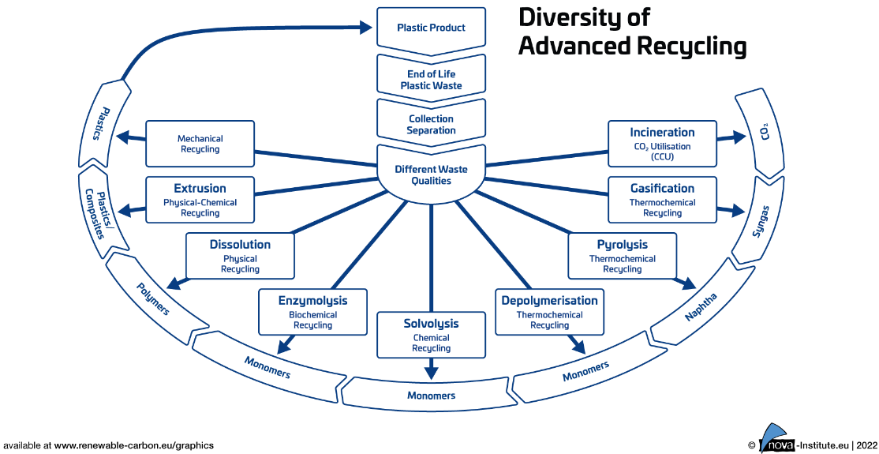
Diversity of Advanced Recycling Processes
There are two overarching conversion technology pathways: thermolysis and solvolysis. Thermolysis, or plastics-to-fuels, includes thermal cracking, pyrolysis, gasification, hydrothermal liquefaction and catalytic pressureless depolymerization. In solvolysis, or “plastic-to-plastic” chemical recycling, plastic waste is converted to monomers as a feedstock for new polymers, and includes technologies such as hydrolysis, alcoholysis, and methanolysis, glycolysis and aminolysis.

Slide 10
Challenges for Chemical/Advanced Recycling
Adoption Hurdles
Suitability
Competition
Opposition
Includes process and technology challenges, high startup and operating costs, underdeveloped domestic markets for recycled products, and limited incentives for recycling innovation and investment though this may be changing.
Chemical recycling may not be suitable for all types of plastic, particularly when polymer chains are irreversibly bonded together.
Virgin plastics are typically cheaper to produce than recycled plastics, in part due to transportation costs and limited recycling infrastructure, making it hard for recycling processes to compete.
Some environmental groups oppose advanced recycling on the grounds that it does not truly reduce GHG emissions and actually increases air pollution, harming vulnerable communities.
Lifecycle Analysis
LCA is not settled: A recent study found of LCAs found that GHG emissions can be reduced up to 185% or can be increased up to 267% with the implementation of AR technologies.

Slide 11
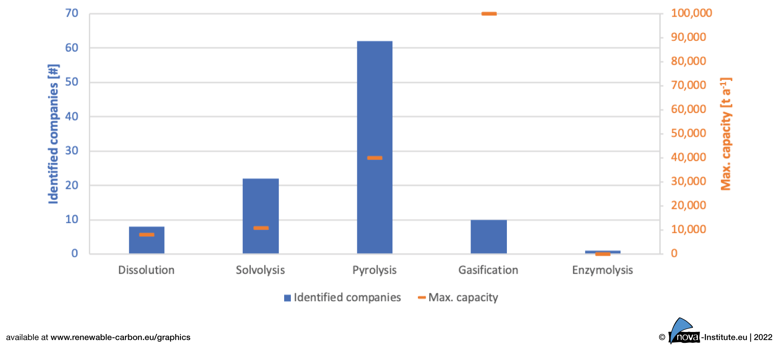
Pyrolysis Technology Providers
Advanced Recycling Production Processes and Capacity, 2022
More than 60 pyrolysis technology providers have been identified globally.

Slide 12
Market Information
The top 5 plastic producers by market capitalization today are ExxonMobil, INEOS, BASF, ENI, and SABIC.
An analysis by the Minderoo Foundation, an Australia-based philanthropic organization focused on the environment, found that 1.5 million tons of advanced recycling capacity globally will be dedicated to fuels production.
Another estimate projects that the market for advanced recycling technologies (which would include fuels) is projected to exceed $9 billion by 2031, up from $270 million in 2022.
According to McKinsey, advanced recycling could satisfy 4 to 8 percent of total polymer demand by 2030 and would require the deployment of more than $40 billion in capital investment over the next decade.
It also found the technology has the potential for more than 20 percent year-over-year growth through 2030.

Slide 13
U.S. Approach: Big Controversy

Slide 14
IRA Provisions Related to Transport Energy IIJA Provisions Also Included but Mostly Focus on Hydrogen and CCS R&D
Hydrogen
CCUS
Renewable Electricity
Clean Fuel Production
SAF
EVs

Slide 15
What about the Clean Fuel Production Tax Credit?
Key Provisions of the CFP for Highway Fuels & SAF (Section 45Z)
Feature | Summary
Who Receives | Fuel producers that sell transportation fuels for highway vehicles and aircraft
Expiration | Dec. 31, 2027
Must Meet These Requirements | Must be suitable for use in a highway vehicle or aircraft Must have an emissions rate not greater than 50 kilograms CO2e per MMBtu as determined by GREET Not derived from co-processing with petroleum Must be registered with the IRS In addition, for SAF: Liquid fuel, the portion of which is not kerosene Sold for use in an aircraft Meets requirements of ASTM D7566 or ASTM D1655 Annex A1
Applicable Amount | Highway: US$0.20/gallon SAF: US$0.35/gallon
Bonus Rate | Highway: US$1.00/gallon SAF: US$1.75/gallon

Slide 16
Key Philosophy Underpinning the Act: Domestic Jobs There is an impression in the market that everyone will get full tax credits, but the bonuses only apply to new construction.
Prevailing Wage
Apprenticeship
The taxpayer must ensure that any laborers and mechanics are paid prevailing wages during the construction of a project and, during the relevant credit period, for the alteration and repair of such project.
A taxpayer must ensure that no less than the applicable percentage of total labor hours for the construction of a project are performed by qualified apprentices.
If a taxpayer fails to satisfy this requirement during a particular year, the taxpayer may cure the failure by (a) paying each worker the difference between actual wages paid and the prevailing wage plus interest (increased to three times this amount in the case of intentional disregard) and (b) paying a $5,000 penalty ($10,000 in the case of intentional disregard) for each worker paid below the prevailing wage during the taxable year.
The applicable percentage is 10% for projects beginning construction before 2023, 12.5% for projects beginning construction during 2023 and 15% for projects beginning construction thereafter.
Each contractor and subcontractor who employs four or more individuals to perform construction on an applicable project must employ at least one qualified apprentice.
If a taxpayer fails to satisfy this requirement, it can nonetheless qualify for the “bonus” rate if it pays a penalty to the IRS equal to $50 ($500 in the case of intentional disregard of the requirement) multiplied by the total labor hours for which the apprenticeship requirement was not satisfied.

Slide 17
Section 45Q: Carbon Capture and Storage (CCS) Credit
Changes to the CCS Thresholds in the IRA
 | Original § 45Q Thresholds (Tons) | New § 45Q Thresholds under the IRA (Tons)
DAC Facilities | 100,000+ | 1,000+
Carbon utilization projects | 25,000-500,000 | Carbon utilization projects subject to individual project thresholds
Industrial facilities (e.g., ethanol, steel, cement, chemicals) | 100,000+ | 12,500+
Electric generating units (e.g., coal, natural gas, biomass-fired power plants) | 500,000+ | 18,750+
CCS/DAC Credits in the IRA
 | Original Tax Credit | New 45Q Credit in IRA for Industry & Power | New 45Q Credit in IRA for DAC
For dedicated secure geologic storage of CO2 in saline or other geologic formations | $50/ton | $85/ton | $180/ton
For carbon utilization projects to convert CO2 into useful products (e.g., fuels, chemicals, other products) | $35/ton | $60/ton | $130/ton
For secure geologic storage of CO2 in oil and gas fields through EOR | $35/ton | $60/ton | $130/ton

Slide 18
IRA/IIJA (BIL) Is Driving More Development of AR
Provision (Legislation) | Summary
Energy Infrastructure Reinvestment Financing (IRA) | The IRA appropriates US$5 billion in loan funding to be disbursed by DOE’s Loan Programs Office for projects that would retool, repower, repurpose or replace energy infrastructure that has stopped operating, or enable operating energy infrastructure to avoid, reduce, use or sequester air pollutants or GHG emissions. Funding has been authorized to Sept. 30, 2026, and terms of any loans cannot exceed 30 years.
Advanced Energy Manufacturing and Recycling Grant Program (IIJA) | The IIJA allocated US$750 million to provide grants to small- and medium-sized manufacturers to enable them to build new or retrofit existing manufacturing and industrial facilities to produce or recycle advanced energy products in communities where coal mines or coal power plants have closed. A request for information was issued by DOE with initial comments due Aug. 2, 2022. The application opened Feb. 13, 2023, and funds will be distributed on a rolling basis until the funding is used up.
Industrial Decarbonization Program (IIJA) | The IIJA allocated US$6.3 billion to establish demonstration projects that test and support technologies to reduce industrial emissions. Eligible uses include industrial production processes that, among other things, “achieve emissions reduction in chemical production processes, including by incorporating, if appropriate and practicable, principles, practices, and methodologies of sustainable chemistry and engineering.” The application opening date will be sometime in 2023.
Innovative Technologies Loan Guarantee Program (IIJA and IRA) | The IRA provided an additional $40 billion of loan authority for projects eligible for loan guarantees to remain available through Sep. 30, 2026.

Slide 19
States with Advanced Recycling Laws More than 20 U.S. states have enacted legislation in the last five years exempting advanced recycling facilities from often complex and onerous environmental requirements, especially those concerning air pollution and solid waste, that apply to traditional waste/recycling facilities.

Slide 20
State Clean Fuel Standards (CFS)
More legislative activity in 2023 for CFS programs, but it has not translated into actual adoption yet
Key
 | LCFS/CFS In Effect
 | CFS Introduced in State Legislature
 | State Discussing CFS, No Legislation Yet
Source: Transport Energy Strategies, July 2023 citing Drive Clean, State Sources
Theoretically, producers could qualify for state CFS programs, if they can meet carbon intensity (CI) reduction requirements. They will have to apply and receive approval for pathways to be able to register and participate in the programs. There is only one producer, Fulcrum, that has applied and received approval for such a pathway under the California LCFS.

Slide 21
EU Approach: Big Waste Problems

Slide 22
Most EU Countries Do Not Meet Recycling Targets
Around 60 percent of Europe’s plastic packaging waste is still not recycled, and much of it is sent to incineration plants. About 30 million tons of plastic waste generated every year in Europe is simply incinerated to generate energy and heat.
The EU’s Joint Research Centre (JRC) concluded in a study that waste management systems in EU countries are “poor”, with only 38 percent of plastic packaging recycled last year.

Slide 23
Waste Incineration in the EU
Most EU countries burn more plastics now than a decade ago, and dozens of new plants are planned in Poland and Czech Republic.
Data show that even those countries with fewer incinerators burn more waste than ever and concerns have been raised about toxic releases into the environment.

Slide 24
EU Plastic Waste Flows Waste burning increased 40% between 2018-2020 after China banned imported wastes

Slide 25
Regulatory Landscape for Waste Management
Source: Topsoe, April 2022
Notes: WFD (Waste Framework Directive), PRF (Port Reception Facilities Directive), MSFD (Marine Strategy Framework Directive), REACH (Registration, Evaluation, Authorization and Restriction of Chemicals), ETS Emissions Trading System, PPWD (Packaging and Packaging Waste Directive), SUPD (Single-Use Plastic Directive).

Slide 26
Enter Chemical Recycling as a Solution
Planned Investments in Chemical Recycling in the EU
According to Plastics Europe, the industry plans to invest €2.6 billion by 2025 and €7.2 billion by 2030, respectively, with 44 planned projects in 13 EU countries.
Conversion to feedstock technologies (pyrolysis, gasification) represents 80% of planned projects which are projected at 1.2 million tons (Mt) capacity by 2025 and 3.4 Mt in 2030.
By comparison, the Commission’s Circular Plastics Alliance target is 10 Mt recycled plastics used in European products by 2025.
Source: Plastics Europe. Note: For exact location, feedstock and capacities see https://plasticseurope.org/sustainability/circularity/recycling/chemical-recycling/

Slide 27
Barriers to Full Commercial Development in the EU
Single Market: “To improve the circularity of plastics, we need to collect and sort more plastic waste, and make sure it gets sent to recycling facilities. These facilities need sufficient quantities of plastic waste to become operational. Creating a larger market for plastic waste and allowing plastic waste to be moved between EU member states is paramount to increasing recycling rates.”
Recognizing Chemical Recycling under Relevant Legislative Frameworks: “Chemical recycling and its role need to be recognized under all relevant EU waste and product legislation. Otherwise, waste treated by chemical recycling will not count against EU recycled content target discouraging the market from buying chemically recycled products.”
Mass Balance Approach Needed: “Since it is impractical to build an entirely new stand-alone infrastructure to produce plastics solely from recycled waste, we need to make use of the existing facilities. This is only possible if we mix recycled feedstock with the virgin one. In this case, we need a methodology to calculate and verify the amount of recycled content allocated to final products based on the amount of recycled feedstock that was put into the system.” Cefic notes that the mass balance approach needs to:
Exclude recycled feedstock that provides energy.
Allow “credit transfer” to be able to assign recycled content produced in one location for products produced in a different location (but within one company, for the same products and within specific geography). Without it, the “physical” transfer of recycled content would lead to unnecessary additional costs and emissions from transport & logistics.
Be verified and then certified by third party.
Encourage Investments: This will help scale the value chain.

Slide 28
AR Under REDIII/RFNBO Provisions
Fuels from chemical recycling would be considered a recycled carbon fuel for purposes of the Renewable Energy Directive (REDII/III).
A new Article 29(a) under REDIII pertaining to renewable fuels of non-biological origin (RFNBOs) is clear that RFNBOs must meet a 70% GHG emissions savings to count toward REDIII targets.
Whether projects can meet the 70% requirement will come down to a project-by-project assessment that will have to take into account how much credit the project will receive for displacing waste volumes from incineration.
Another issue not fleshed out at this point is precisely what feedstocks might qualify under the legislation.
The RFNBOs Delegated Act is clear that in the case of recycled carbon fuels, “only liquid or solid waste streams of non-renewable origin which are not suitable for material recovery in accordance with Article 4 of Directive 2008/98/EC [the Waste Framework Directive]…waste processing gas and exhaust gas of non-renewable origin which are produced as an unavoidable and unintentional consequence of the production process in industrial installations can be considered as relevant energy input for the production of recycled carbon fuels.”

Slide 29
Conclusions

Slide 30
Conclusions: AR Potential on Both Sides of the Pond
U.S.
EU
Advanced recycling production of transportation fuels is nascent in the U.S., but recent policies enacted under the IRA and Bipartisan Infrastructure Law (BIL/IIJA) are expected to support scale up.
More than 20 U.S. states have enacted legislation in the last five years exempting advanced recycling facilities from environmental regimes that were structured for other types of recycling facilities.
The U.S. Environmental Protection Agency withdrew a similar proposal this year.
There is an existing $120 billion addressable market in the U.S. and Canada alone for plastics and petrochemicals that could be met, in part, by recovering waste plastics.
There is significant and growing opposition to advanced recycling from the NGO community which may serve to derail the industry’s growth potential in general.
There is potential to scale up chemical recycling as a pathway to help tackle a growing waste problem in the EU.
According to Plastics Europe, the industry plans to invest €2.6 billion by 2025 and €7.2 billion by 2030, respectively, with 44 planned projects in 13 EU countries.
Conversion to feedstock technologies (pyrolysis, gasification) represents 80% of planned projects which are projected at 1.2 million tons (Mt) capacity by 2025 and 3.4 Mt in 2030.
Much of this will go toward petrochemicals, but there is potential for transport fuels as well, particularly SAF.
There are challenges including cost, lifecycle analysis (which will be needed to meet GHG thresholds under application legislation) and the question of tracking and appropriately counting feedstocks.

Slide 31
Tammy Klein Founder & CEO +1.703.625.1072 (M) tammy@transportenergystrategies.com

